Slide 1
APP for Local Martial Arts School
Josue Mendoza

Slide 2
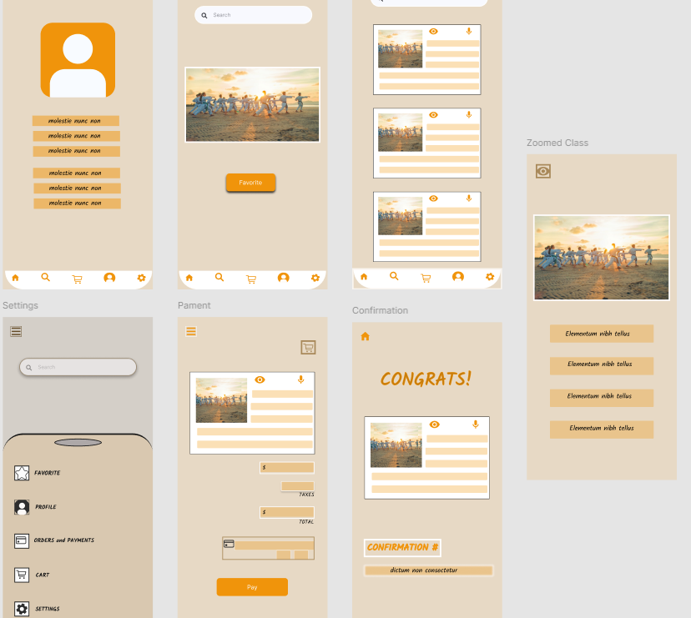
Project overview
The product:
I’m creating a Karate school app to help the school transition towards an online enrollment system. The app will be able to help parents plan accordingly in advance, streamline the registration and payment process.
Project duration:
August 2022 to Dec 2022

Slide 3
Project overview
The problem:
Coming up with a solution to make the app user friendly for our diverse community, checking if the app helps families with multiple children save time. Having an easy checkout process.
The goal:
Making an app that is inclusive and adding features to make it user friendly to all.

Slide 4
Project overview
My role:
lead UX designer, UX researcher, UX writer
Responsibilities:
user research, wireframing, low & high fidelity prototyping,

Slide 5
User research
Personas
Problem statements
User journey maps
Understanding
the user

Slide 6
User research: summary
I used an unmoderated usability study, that was conducted remotely within the USA. I had six participants that completed individual registration task within the app. One of the participants is randomly chosen to register a family of four. Each participant will complete a questionnaire about their experience. Each session will last 20 minutes, including an introduction and list of tasks. One of the main focus was Figuring out how to make the app user friendly for our diverse community, checking if the app helps families with multiple children save time. I soon found that I needed to add more features from zooming in to a speech to text option for classes.

Slide 7
User research: pain points
1
2
3
4
navigate without log in
view/select multiple classes
Unable to save favorite class.
Fast check out not an option
IN general, users want a fast checkout process that doesn’t require many steps. This would be a great addition to add a fast checkout process.
Users want the ability to have a link to favorite classes to make it easier to locate. Adding a favorite feature would be a great addition.
In general, users want to browse the classes without login. Give the users the ability to view classes before login.
Users would want to book multiple selection at a time and view multiple classes.

Slide 8

“You can be safe and still enjoy any sports activity”
Add image that represents this persona
Goals
Maintaining a high standard of safety and fun in all my classes
Educating all participates in proper gaming
Introducing little ones to new sports.
Frustrations
The lack of new equipment
Play area not safe enough for people of all ages
Having consistent maintenance
Tim
Age:
Education:
Hometown:
Family:
Occupation:
30 B.A. Science Portland, OR Single
Instructor
Tim is a instructor for one of the community centers in portland. They teach a large variety of classes ranging from ages 1-8.Timmi wishes that the conditions of the gym floor would be in better shape. Because, He had an adult slip during his class because of the poor maintenance of the floor.

Slide 9
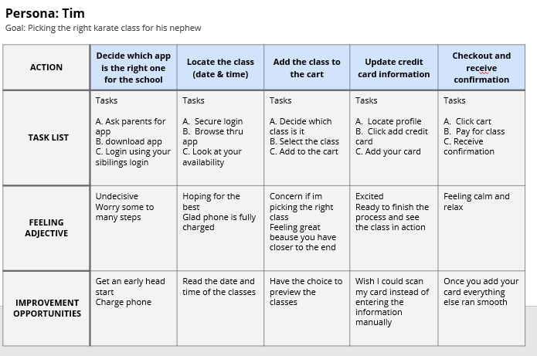
User journey map
Mapping Tim’s user journey revealed it would be helpful to add a favorite button and Increase font size; Adding a speak to read option is important. Want to allow the user to be able to mold their experience to fit their needs.

Slide 10
Paper wireframes
Digital wireframes
Low-fidelity prototype
Usability studies
Starting
the design

Slide 11
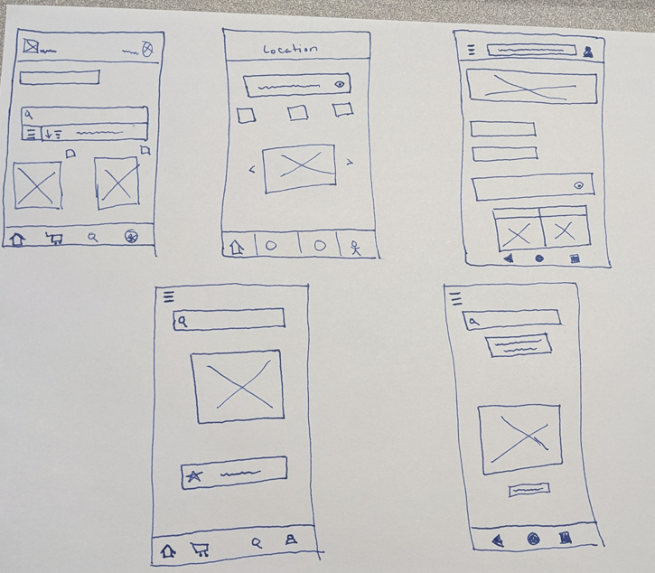
Paper wireframes
Drafted screens of the app on paper, while keeping in mind the pain points that were discovered. For the home screen, I drafted different styles prioritize a quick browsering and ordering process.

Slide 12
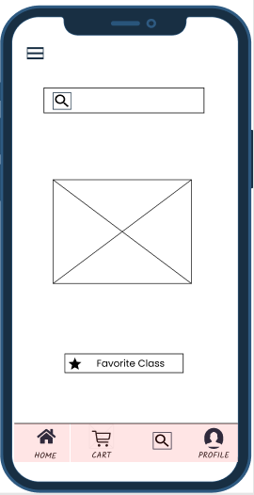
Digital wireframes
The customer has the option to either search or naviagte thru the app without having to go thru many different screens
Focusing on making it as clean looking as possible, while keeping the user research feedback in mind.
Added a short cut to favorite classes so that it can expedite checking out processes

Slide 13
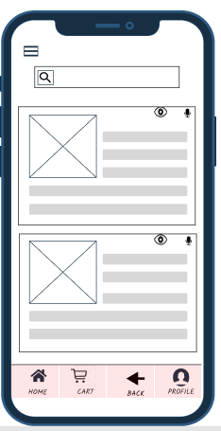
Digital wireframes
Focused on making it as inclusive as possible epecially for indivuals that have a difficult time seeing the letters on their screens.
Added the options to either zoom in or have the app read the classes descriptions
Added the ability to go back and return to the previous screen, in case they want to add or change order

Slide 14
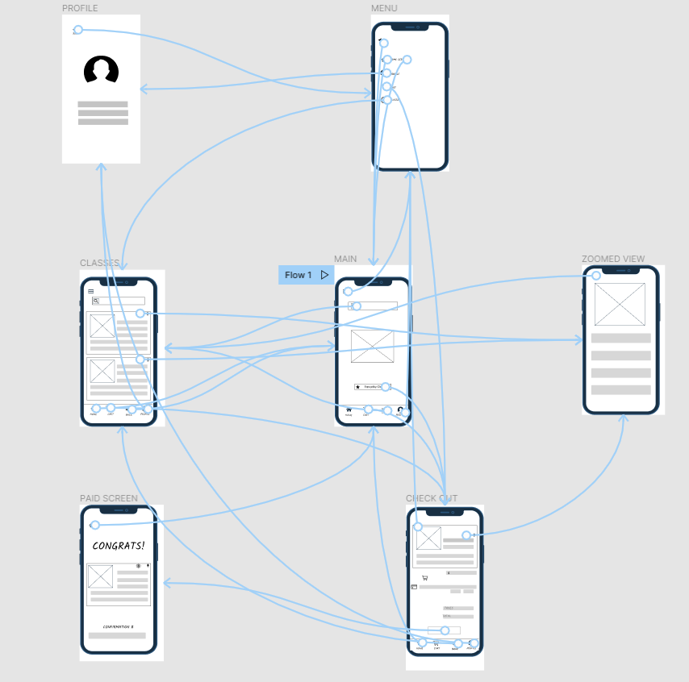
Low-fidelity prototype
Used completed screens to make a low-fidelity prototype. The user flow I created is to search and pick a karate class for users.
Screenshot of prototype with connections or prototype GIF

Slide 15
Usability study: findings
Conducted an unmoderated usability study, that was performed remotely within the USA. I had six participants that were given different task numbers and directions to complete using the app. We had a few findings and suggestions that each individual felt would make their experience smoother
Round 1 findings
Round 2 findings
1
Able to browser without login
1
User wants to save favorite class
2
Fast checkout
2
User wants bigger font
3
User wants shortcuts
3
User wants a confirmation animation

Slide 16
Refining
the design
Mockups
High-fidelity prototype
Accessibility

Slide 17
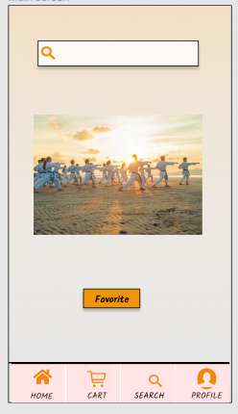
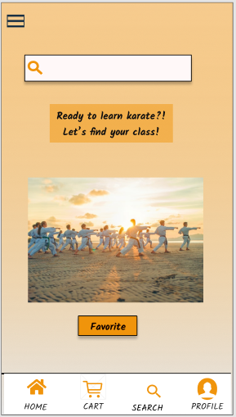
Mockups
Before usability study
After usability study
Felt the early design was messing some key elements, based on user study I added some key buttons to allow customer to move from screen to screen.

Slide 18
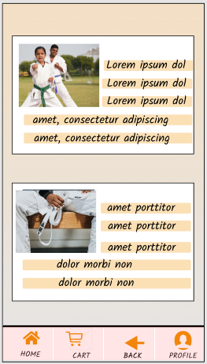
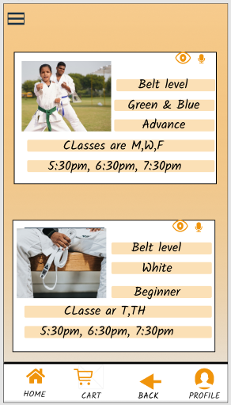
Mockups
Before usability study
After usability study
Round two of the usability study revealed the customer wanted larger font, so I added a zoom/ text to speech option and add a menu button to allow fluidity within the app.

Slide 19
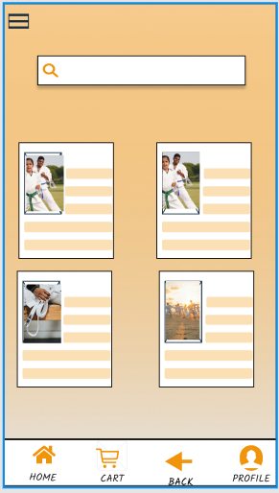
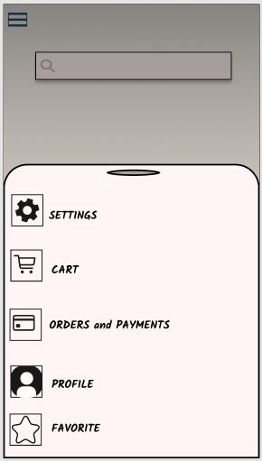
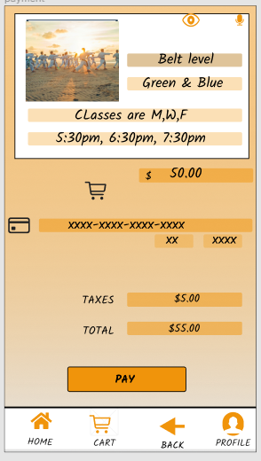
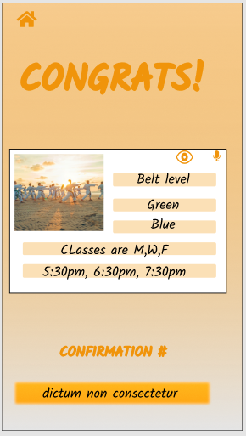
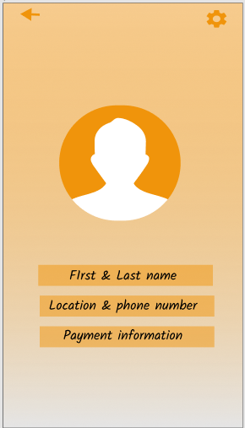
Mockups

Slide 20
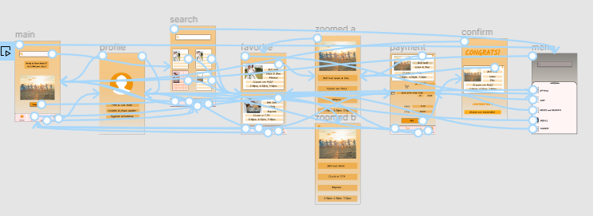
High-fidelity
prototype
Finale high-fidelity prototype present animations and clean flow for users to be able to search and pick classes.

Slide 21
Accessibility considerations
1
2
3
Used hamburger icon to provide easy navigation between screens.
Provided access to users who are vision impaired by adding speak to text option and zoom option.
Used familiar imagery from buttons to adding full images of classes to help all users find classes easier.

Slide 22
Going forward
Takeaways
Next steps

Slide 23
Takeaways
Impact:
The karate app give users a low stress environment for all ages, making it personable for all customers.
One quote from peer feedback:
“The app looks great very vibrate colors and the animations are great. I love the pictures you added and the ability to zoom in the class details.
What I learned:
During the designing process of the karate app, I learn quickly that my idea were great but after the first usability process I learned that there are key things to keep in mind and to add to help the user flow become flawless.

Slide 24
Next steps
1
2
3
Run another round of usability studies to make sure all the pain points have been addressed.
Run another user research to determine any new areas that need improvement..
Adjust the animations/speed between pages to make the app flow better.

Slide 25
Let’s connect!
Thank you for your time reviewing my work on the Karate school’s app. Feel free to reach out, my contact information is provided below.
Email: Josue.mendoza12@outlook.com

Slide 26
Thank you!

